Slide 1
PRUDENTIAL DATATHON (Group 8)
-JIAMIN WANG
-HANAN ALSALAMAH
-NAUKA SALOT
-ABHINAV TIWARI

Slide 2
APPROACH
OBJECTIVE
To analyze the Prudential Life Insurance dataset and predict the data points in the existing evaluation and sanction the outcomes to significantly amalgamate the process by building the Linear Regression, Decision Tree Regression, SVM Regression and XGBoost linear booster models to conclude the results.
Built a predictive model for Prudential Life Insurance by evaluating the risk factor associated with various parameters in an application to accurately classify risk on a scale of 1-8 (8 being the highest) using a more automated approach.

Slide 3
DATA PREPARATION
The data contains 110 categorical variables, 13 continuous variables and 5 discrete variables.
Categorical variables contain a finite number of categories. Such as (Product_Info_2)
Discrete variables are numeric variables that have a countable number of values between two values. Such as (Medical_History_10)
Continuous variables are numeric variables that have an infinite number of values between two values. Such as (BMI)

Slide 4

DATA PREPARATION
The first step was to check for any noise in the data, but after analyzing the dataset was found to be noise-free.
The second step was to find out the percentage of null values in each column and remove the columns having more than or equal to 70% null data and also remove the id column.

Slide 5
TREATING THE NULL VALUES
Replaced the null values in each column using the mean of that column.
Checked the sum of NA variables of a specific column to be zero after filling in the mean value.
Settled the categorical columns to as a factor to get factors with n levels.

Slide 6
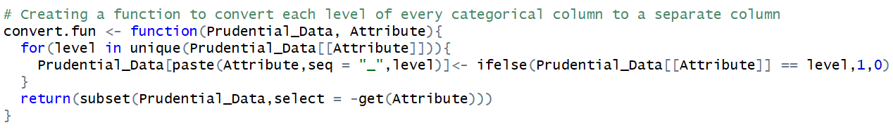
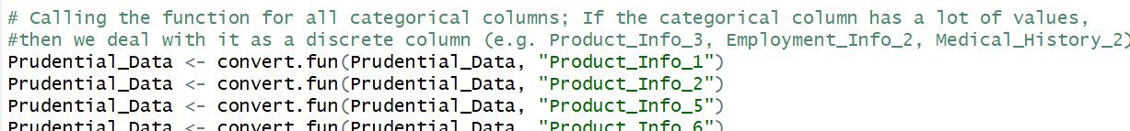
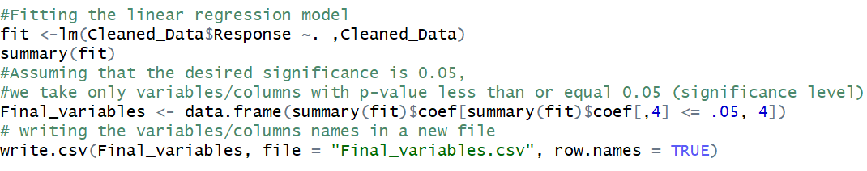
DATA TRANSFORMATION
Creating a function to convert each categorical column to its numeric representation
Calling the function for Categorical Columns
Fitting the linear regression model and taking the significant variables only

Slide 7

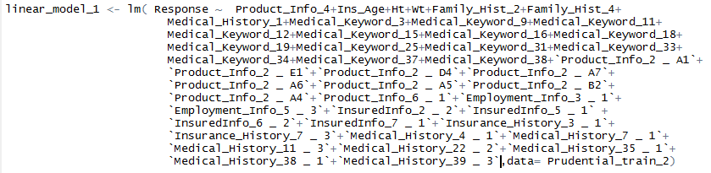


PERFORMING LINEAR REGRESSION
LINEAR REGRESSION
It is used for modeling the relationship between a dependent variable Y and one or more independent variables denoted as X.
Used the cleaned training data to construct the linear model using lm()
From the summary of the model, removed the columns with less significant p values and redesigned the model focusing on the R-Squared and RMSE values.

Slide 8


LASSO REGRESSION
Applied Lasso Regression, to decrease the RMSE of the model.
The final value of RMSE is

Slide 9
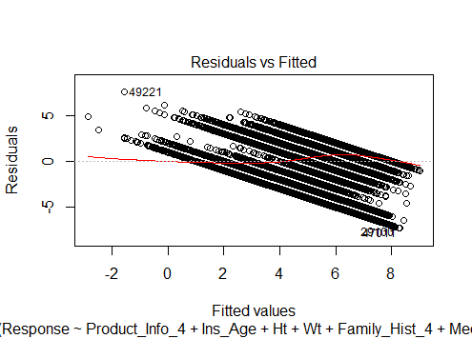
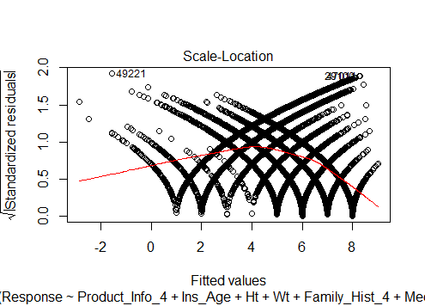
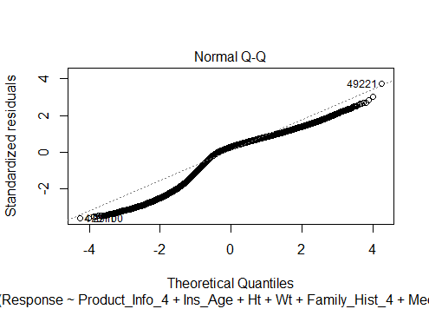
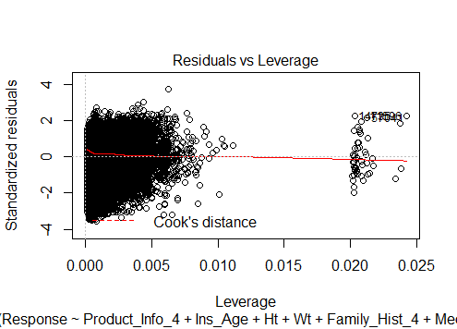
DATA VIZUALIZATION

Slide 10
Decision Tree Regression
Decision Tree is a supervised learning algorithm.
It uses the ID3 top-down search algorithm to select and split the attributes and build the tree shaped diagram.
The tree has decision nodes and leaf nodes. The decision node in a tree which corresponds to the best predictor is the topmost node (root node).
The steps of performing Decision Tree Regression on prudential dataset:
Retrieving the final preprocessed data and splitting dataset into 80% train and 20% test datasets.
Fitting the model using rpart() on train dataset to train the model.
Printing plots for train data and plot the decision tree
Plot cross-validation results.
Predicting the Response for test data.
Printing the confusion matrix and computing the model accuracy and correlation.
Computing the Root Mean Squared Error (RMSE) between actual and predicted data.
Adding the predicted Response column to the dataset and writing it to a new file.

Slide 11
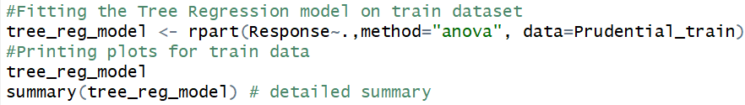
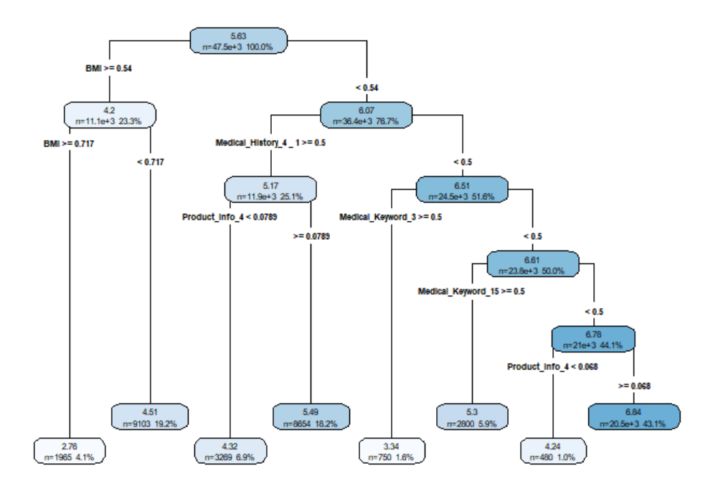
Performing Decision Tree Regression

Slide 12

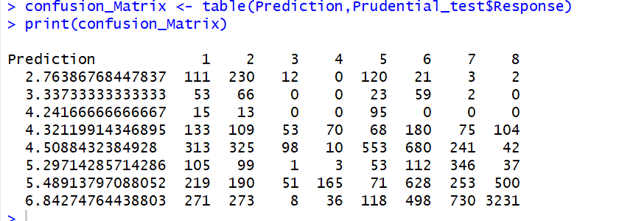

Performing Decision Tree Regression

Slide 13
SVM Regression
Support vector machines (SVMs) are a set of supervised learning methods used for classification regression and outlier.
It is effective in high dimensional spaces.
Different Kernel function can be specified for the decision function.
The steps of performing SVM regression on prudential dataset:
1. Retrieving the final cleaned data and splitting dataset into 80% train and 20% test datasets.
2. Tuning the SVM models to get optimal cost and gamma parameter which will be used for creating SVM model. Four kernels are used: radial, polynomial, sigmoid and linear.
3. Using the parameters calculated with the tune function and train data to fit SVM model.
4. Using the SVM model and test data to predict the Response.
5. Printing the accuracy.
6. After comparing the Root Mean Squared Error(RMSE) of the above 4 predictions, SVM model with linear kernel is the best one because it has the smallest RMSE value.

Slide 14
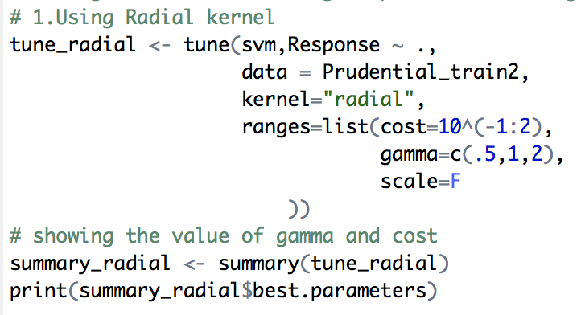
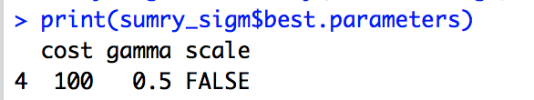
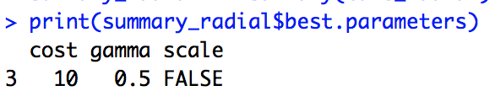
SVM Regression
Screenshots of using tune function to decide the value of parameters:

Slide 15
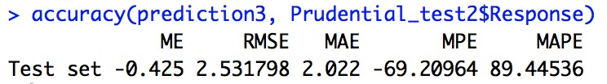
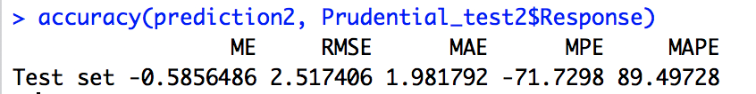
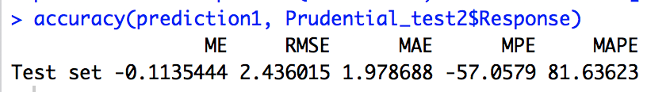
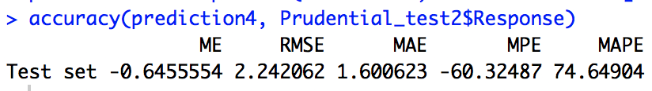
SVM Regression
Screenshots of comparing the value of RMSE to decide with kernel is better:

Slide 16
XGBoost – eXtreme Gradient Boosting
For XGboost, we must set three types of parameters: general parameters, booster parameters and task parameters.
General parameters relates to which booster we are using to do boosting, commonly tree or linear model
Booster parameters depends on which booster you have chosen.
Learning Task parameters that decides on the learning scenario, for example, regression tasks uses different parameters with ranking tasks.
eta [default=0.3, alias: learning_rate]
step size shrinkage used in update to prevents overfitting. After each boosting step, we can directly get the weights of new features. and eta actually shrinks the feature weights to make the boosting process more conservative.
range: [0,1]
gamma [default=0]
minimum loss reduction. The larger, the more conservative the algorithm will be.
range: [0,∞]
lambda [default=1, alias: reg_lambda]
L2 regularization term on weights, increase this value will make model more conservative.
alpha [default=0, alias: reg_alpha]
L1 regularization term on weights, increase this value will make model more conservative.
verbose = 0, no message

Slide 17
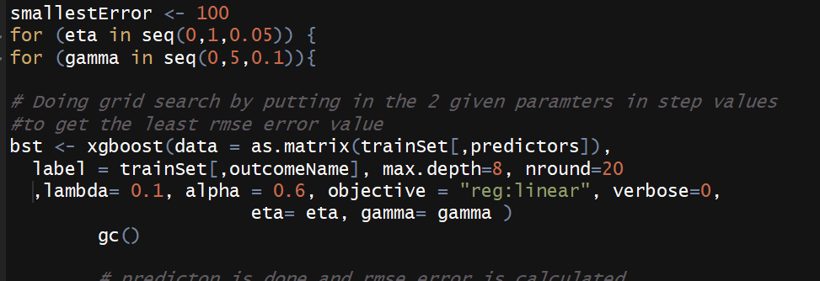
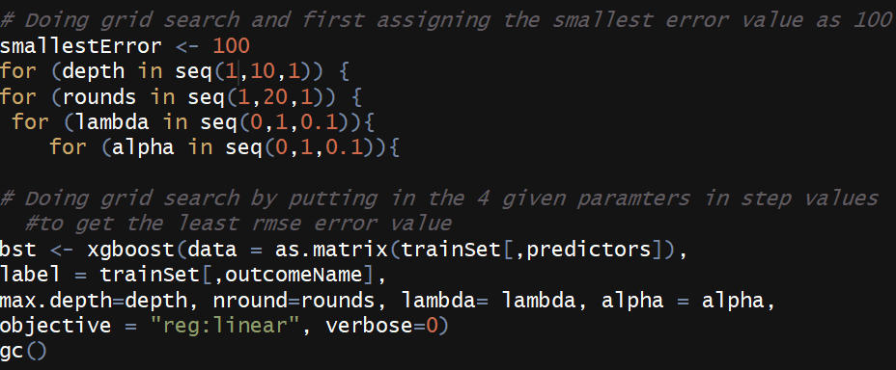
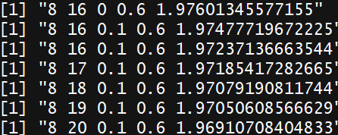
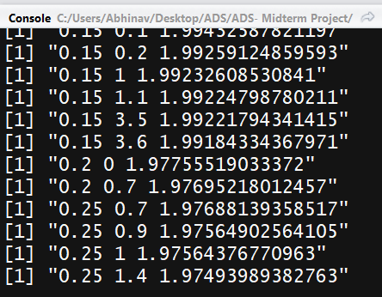
Grid search for various parameters. Using only 10% of the data.

Slide 18
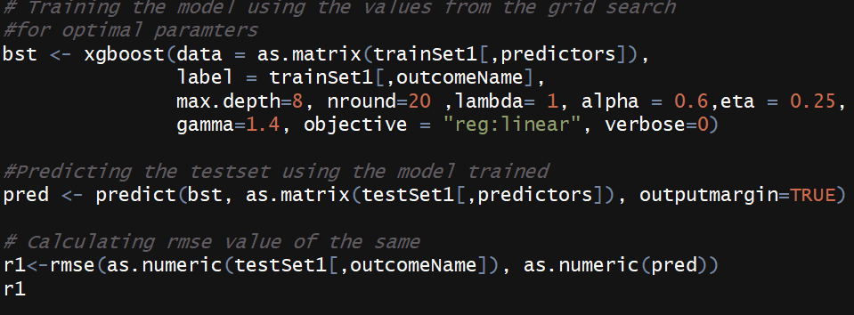
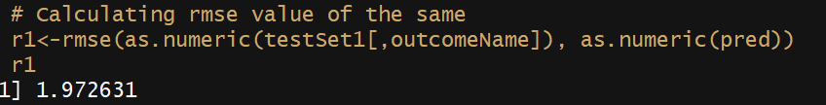
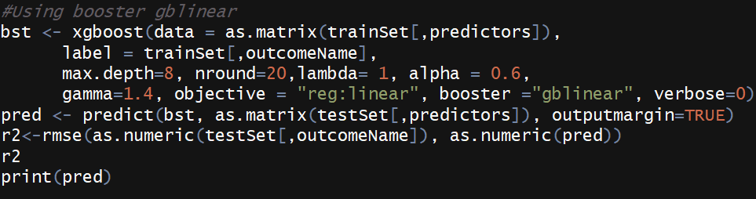

Slide 19
Conclusion
The dataset had 128 features and by feature engineering, we got 64 features which significantly affected the response of the predictive model.
Following are the RMSE values for the different predictive models:
Linear Regression : RMSE 2.336
Decision Tree: RMSE 2.129
SVM : RMSE 2.242
XGBoost : RMSE 1.972
To conclude based on our results, the best predictive model for this dataset is XGBoost.

Slide 20
Future work/recommendations
Data cleaning is the most important aspect to get the best predictions.
We could work on a bigger data set to scale our results and improve accuracy of the predictions in future.
This in turn could be used by various companies to target customer-centric outcomes.

